Slide 1
Integrating Engineering and Management in MIT LGO
March 2012
Don Rosenfield

Slide 2
LGO Tripartite Partnership
Industry Partners
MIT School of Engineering
MIT Sloan School of Management

Slide 3
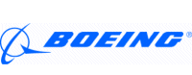







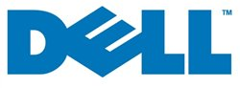















LGO Partners
Companies above line are Governing Board members
March 2012

Slide 4
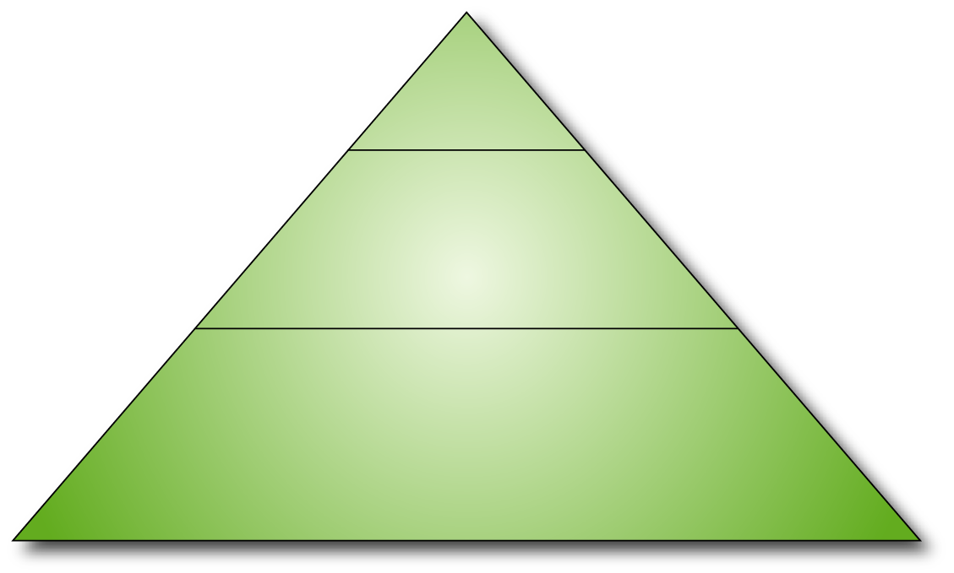
LGO Educational Program
Leadership
Integration
Internship
Operations Management
Product/Process Design
Operations Strategy
High velocity/Lean Six-sigma systems
Plant Visits
Foundations
managerial & organizational
physical
informational
Organizational Processes
Marketing
Strategy
Management Depth
Processes
Engineering Depth
Communication
Accounting & Measures
Information Technologies
economic
mathematical
Markets
Finance
Systems
Probability & Statistics

Slide 5
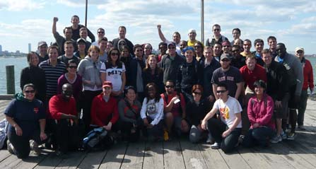
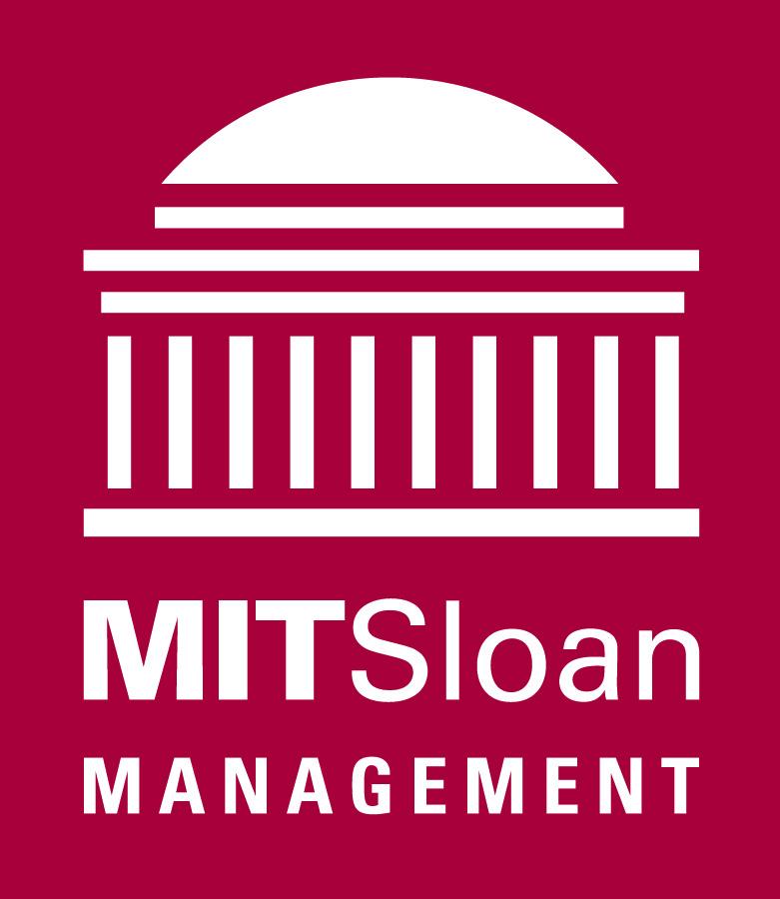

The LGO Program - Education
School of Management:
  MBA core plus electives focused on operations
School of Engineering:
  Six Engineering Departments plus Engineering Systems Division
Leadership:
  Two-year LGO leadership sequence, consisting of classes, seminars, and opportunities to practice and reflect
  Project/program management
24 month program – six months off campus
Program is helping similar program at Shanghai Jiao Tong University

Slide 6
LGO Engineering
Core Programs
Systems Optimization & Analysis for Operations
Engineering Probability & Statistics
High-velocity/Lean six-sigma systems
Course in Product Design and Development
At least 3 additional courses to fulfill a departmental program.

